Slide 1
TELECOMMUNICATIONS

Slide 2
Under the Gudience: Neha guptha Kishore.Rajashekaran
Team members
Lekha Sree Yenneti
Jaya Lakshmi Karavadi
Shirisha Muddangula
Vaishnavi Dappu
Bhadra Laxmi Atike
Akshitha Mudhiraj
HemaLatha Gorantla

Slide 3
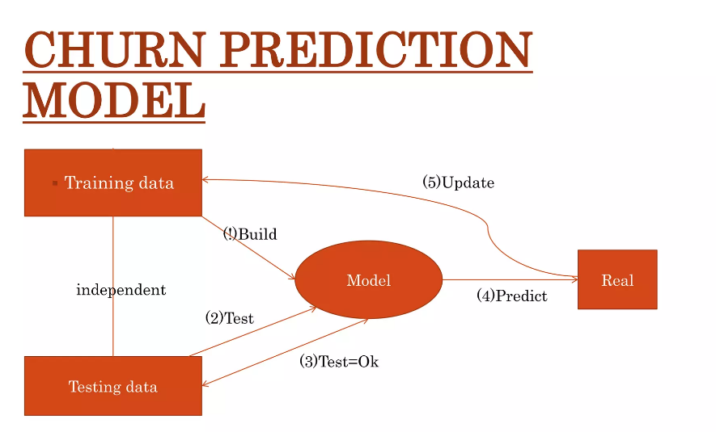
Project Objective :
To Predict Customer Churn .
Highlighting the main variables or factors influencing customer churn.
Use various ML classification algorithms to build prediction models, evaluate the accuracy.
And performance of these models.
Finding out the best model for our business case & providing executive summary.

Slide 4
DataSet Details:
The data file telecommunications_churn.csv contains a total of 19 features for 3333 customers. Each row corresponds to a client of a telecommunications company for whom it has been collected information about the type of plan they have contracted, the minutes they have talked, or the charge they pay every month.

Slide 5
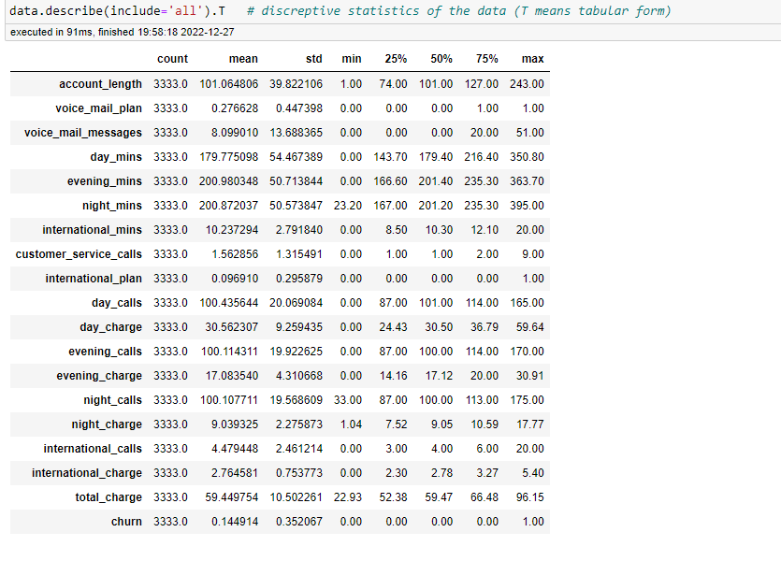
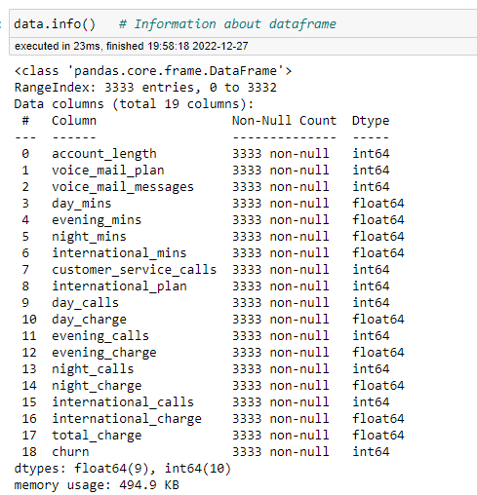
EDA

Slide 6
Break down our features
Account Length : the number of days that this account has been active.
VMail Plan : whether the customer has a voice mail feature: yes/no.
VMail Message : presumably the average number of voice mail messages per month.
Day Mins : the total number of calling minutes used during the day.
Night Mins : the total number of calling minutes used during the Night.
evening Mins : the total number of calling minutes used during the evening.
Intl Mins : the total number of international minutes.
CustServ Calls : the number of calls placed to Customer Service.
Int’l Plan : whether the customer has an international calling plan: yes/no.
Day Calls : the total number of calls placed during the day.
Day Charge : the billed cost of daytime calls.
Eve Calls : the total number of calls placed during the evening.
Eve Charge : the billed cost of evening time calls.
Night Calls : the total number of calls placed during the night.
Night Charge : the billed cost of nighttime calls.
Intl Calls : the total number of international calls.
Intl Charge : the billed cost for international calls.
Total Charge : the total cost summing day, eve, night, international charges.
Churn : whether the customer left the service: true/false.
A higher number of calls placed to customer service in a given period indicates that a customer is facing many problems, and hence, there is a high potential of churning.
Customers with high total billed cost are more likely searching for another operator if they are unhappy with the current service.
There are no Null values
There are no duplicated values.

Slide 7
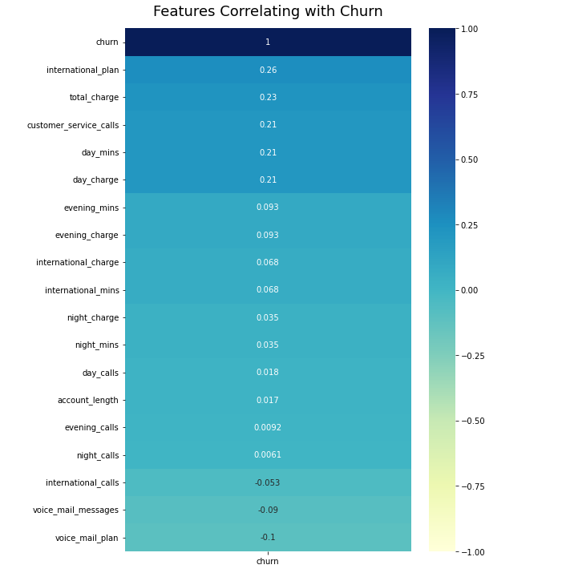
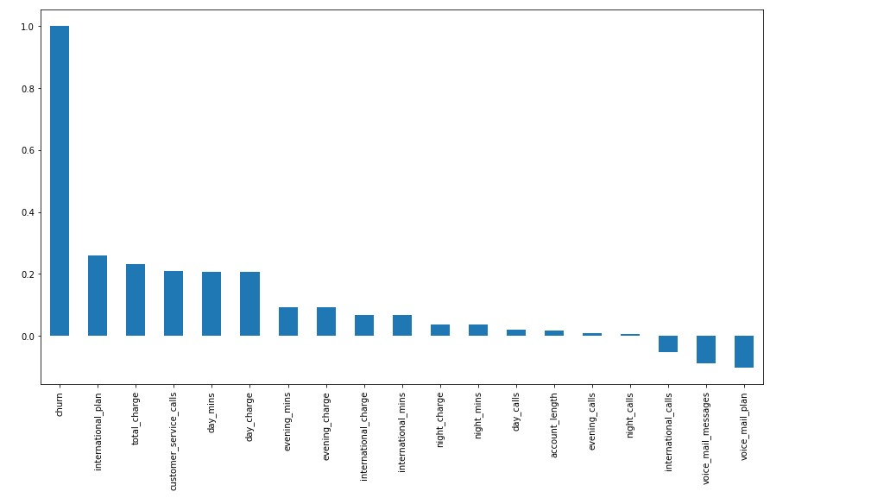
Correlation: correlation is used to measure the relationship between variables how strongly associated or how weakly associated or no association (Except international calls, voice mail messages and voice mail plan everything is positively related to churn.)

Slide 8
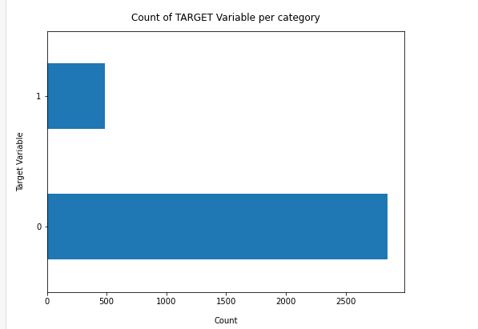
COUNT Plot to analyze CHURN
Count Plot is used to show the count of observations in each features bin using bars.
Here Y is our target variable churn(1,0)
0 indicates NO CHURN
1 indicates CHURN

Slide 9
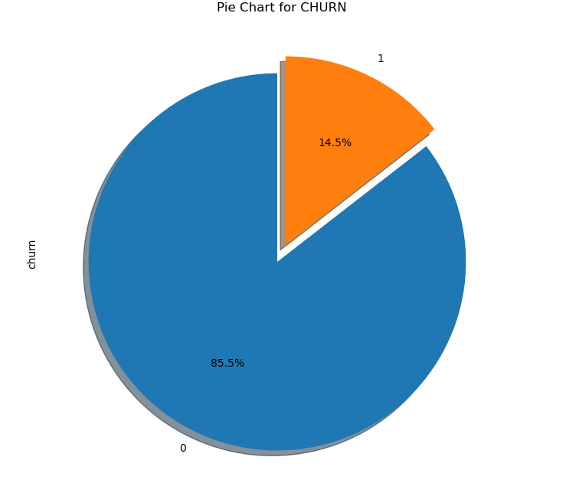
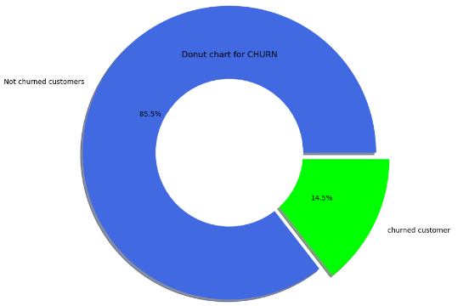
PIE & DONUT Chart to analyze CHURN

Slide 10
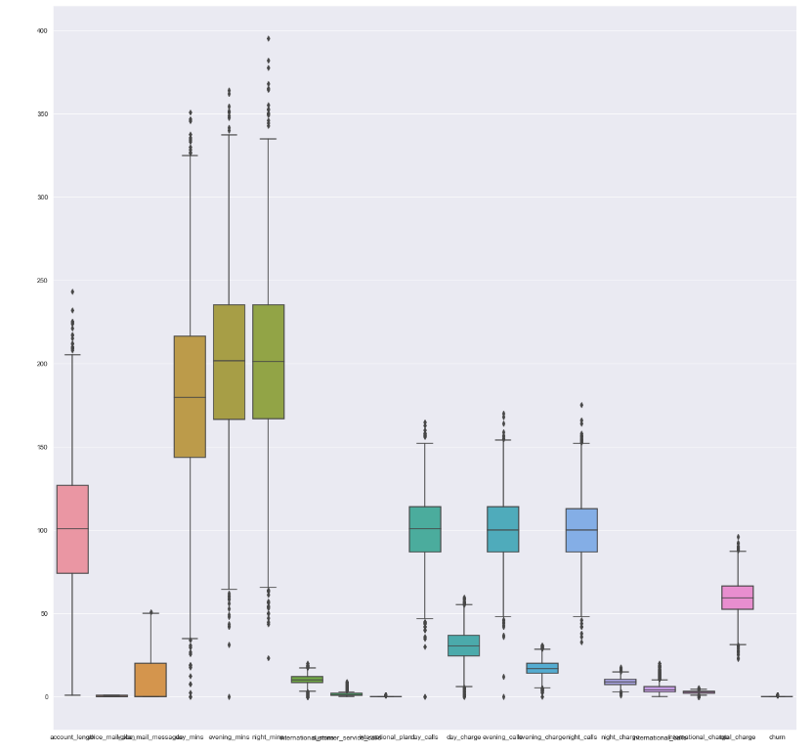
OUTLIERS(BoxPlot)
Account length(18),
Voice mail plan(0),
Voice mail messages(1),
Day mins(25),
Evening mins(24),
Night mins(30),
International mins(46),
Customer service calls(267),
International plan(323),
Day calls(23),
Day charge(323),
Evening calls(22),
Evening charge(24),
Night calls(22),
Night charge(30),
International calls(78),
International charge(49),
Total charge (27),
TOTAL OUTLIERS(1332).
OUTLIER DETECTION AND REMOVAL
Outliers are nothing but values . Those are distinctly different from other values.
(extream values of our data.)
Outliers will gives the correct idea about central value of given dataset.
Here We Use IQR Method For Detecting Outliers and removed

Slide 11
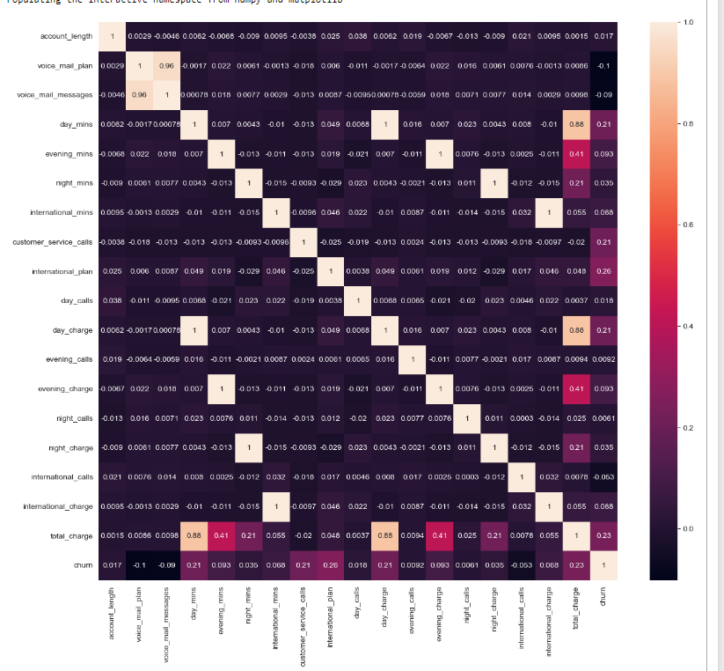
HEAT MAP
The Heat map is used to find the highly correlated values of given dataset
By using correlation threshold method we got Voicemail messages as a highly correlated feature

Slide 12
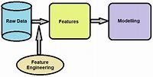
Feature Engineering
By Analysing the Dataset , We had drawn some Insights Required for Model Building.
In feature engineering we used correlation threshold method for dropping highly correlated columns or less correlated columns.
In the given dataset , we dropped voice mail message and churn in X input variable and Y consist of our target variable Churn.

Slide 13
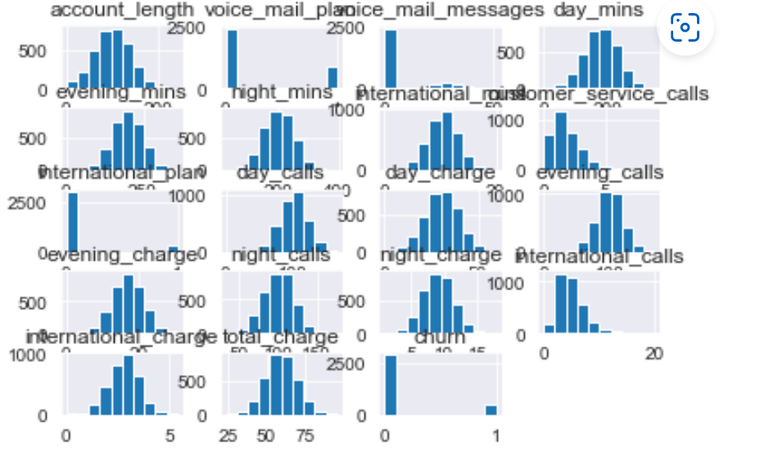
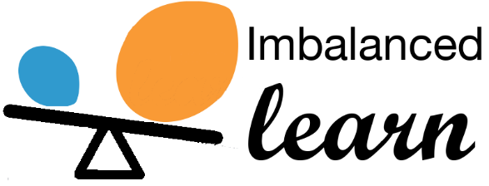
SMOTE+ENN Technique
To change imbalanced data to balanced data we use SMOTE+ ENN Technique.

Slide 14
Model Building :
Decision Tree : A decision tree is a non-parametric supervised learning algorithm, which is utilized for both classification and regression tasks. It has a hierarchical, tree structure, which consists of a root node, branches, internal nodes and leaf nodes.
Support Vector Meachine : A support vector machine (SVM) is a supervised machine learning model that uses classification algorithms for two-group classification problems. After giving an SVM model sets of labeled training data for each category, they're able to categorize new text.
Random Forest : Random forests or random decision forests is an ensemble learning method for classification, regression and other tasks that operates by constructing a multitude of decision trees at training time. For classification tasks, the output of the random forest is the class selected by most trees. For regression tasks, the mean or average prediction of the individual trees is returned.
AdaBoost Classifier : An AdaBoost classifier is a meta-estimator that begins by fitting a classifier on the original dataset and then fits additional copies of the classifier on the same dataset but where the weights of incorrectly classified instances are adjusted such that subsequent classifiers focus more on difficult cases.
AdaBoost Algorithm is also known as Adaptive Boosting is an Ensemble modelling technique used in Machine Learning to find the best model.
KNeighborsClassifier : KNeighborsClassifier is for K nearest neighbor. Standardization of datasets is a common requirement for many machine learning estimators: they might behave badly if the individual features do not more or less look like standard normally distributed data.
Naive Bayes : Naïve Bayes is a probabilistic machine learning algorithm based on the Bayes Theorem, used in a wide variety of classification tasks.
Logistic Regression : Logistic regression is commonly used for prediction and classification problems. Some of these use cases include: Fraud detection: Logistic regression models can help teams identify data anomalies, which are predictive of fraud.

Slide 15
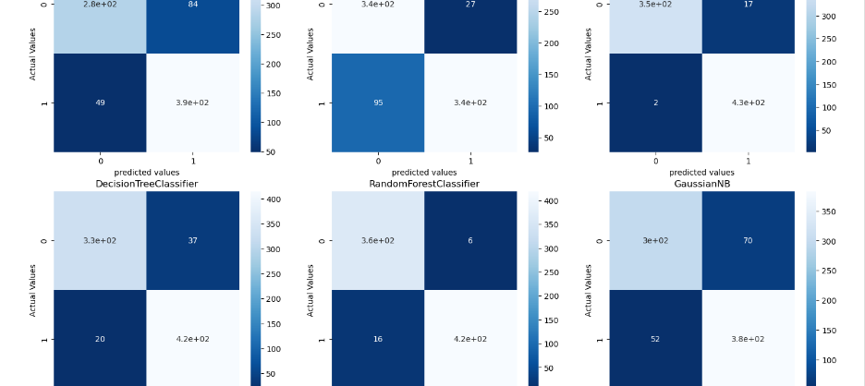
Confusion Matrics
A confusion matrix is a table that is used to define the performance of a classification algorithm.
A confusion matrix visualizes and summarizes the performance of a classification algorithm.
Confusion Matrix is a useful machine learning method which allows you to measure Recall, Precision, Accuracy, and AUC-ROC curve.

Slide 16
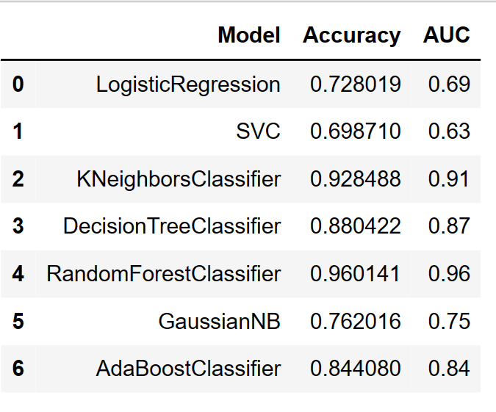
Conclusion :
In the above 7 models,
Random Forest Classifier is given the best accuary values.
Finally move on the deployement which model gives the highest Accuracy value,to move on deployement.
To observe the all models random forest classifier given the highest accuracy value.

Slide 17
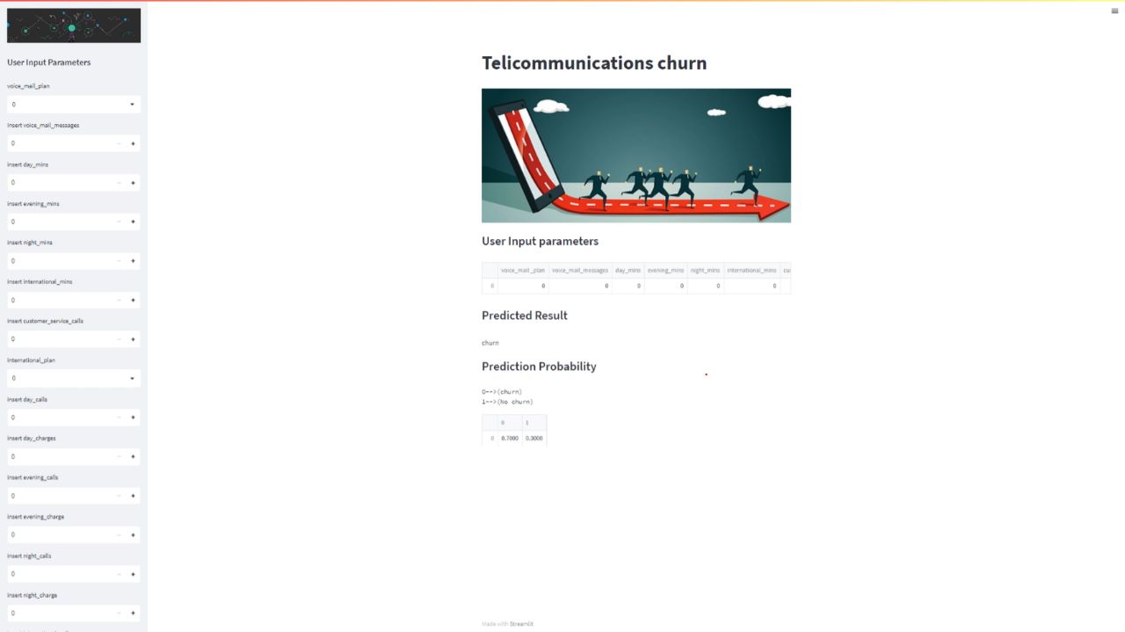
Deployment :

Slide 18
Challenges Faced :
First of all we faced the challenges to understand the the data and we have learn only class room teaching classification methods.
To search different classifications models and to understand the model concepts very to difficult but to need to concentrate the concept is easy.
Local URL: http://localhost:8501
Network URL: http://100.126.94.145:8501

Slide 19
THANK YOU
We team welcomes yours doubts ; Reach us @
berries.lekha@gmail.com
kjljayalakshmi@gmail.com
muddangula.shirisha179@gmail.com
vaishuvaishnavi728@gmail.com
bhadraatike@gmail.com
akshithamudhiraj3@gamil.com
gorantlahema2426@gmail.com

